Slide 1
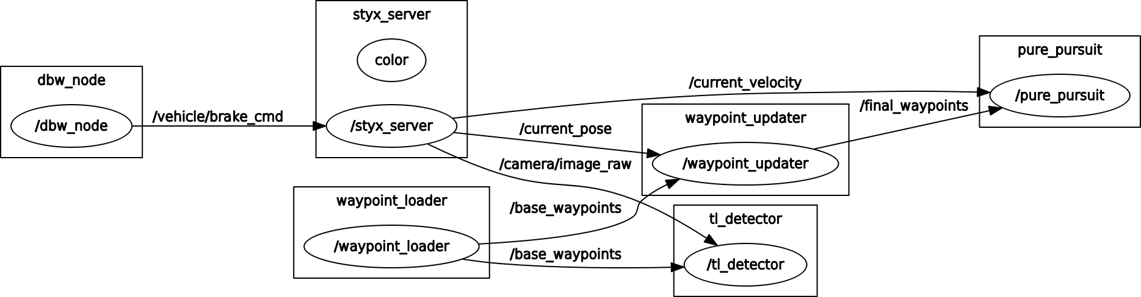
RQT Graph

Slide 2
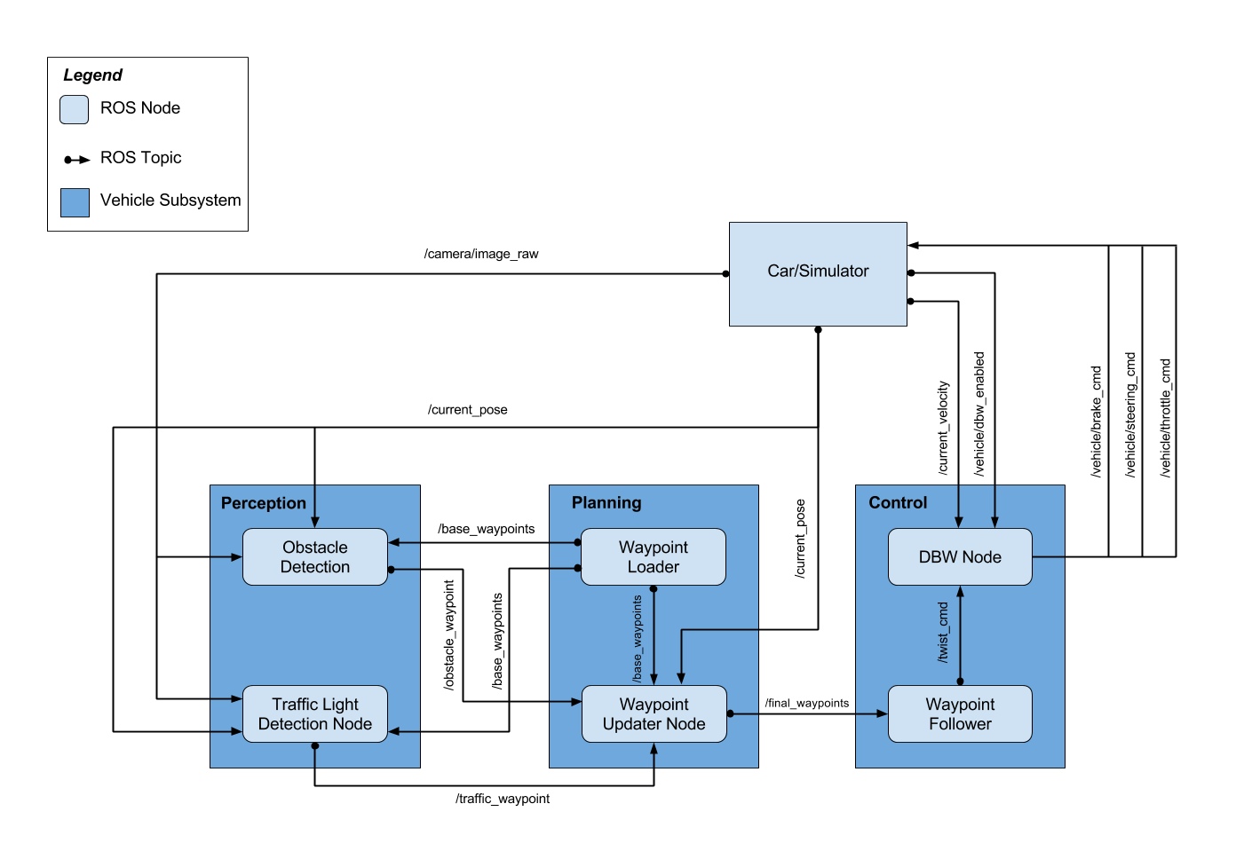
ROS Nodes Layout

Slide 3
Waypoint Files Summary
filename | Column headers | Notes
churchlot_with_cars.csv | Pos x,y,z, yaw(rad) | Yaw is in rad (+/- Pi)
sim_waypoints.csv | Pos x,y,z, yaw(?) | Yaw is constant – bad? Same path as wpt_yaw and wpt_yaw_const
wp_yaw.txt | Pos x,y,z, yaw(deg) | Identical to wp_yaw_const.txt
wp_yaw_const.txt | Pos x,y,z, yaw(deg) | Identical to wp_yaw.txt Yaw is in deg(0-360)

Slide 4
churchlot_with_cars.csv
1 unit of distance traveled
between waypoints
Total Waypoints: 61
Distance Traveled Over Entire Waypoint Path: 68.4871
Column Headers: Pos x,Pos y, Pos z, yaw(rad)
Yaw goes from +/- pi (rad)

Slide 5
sim_waypoints.csv
Yaw angle bad?
Distance between waypoints
not constant, speed changing
Total Waypoints: 11011
Distance Traveled Over Entire Waypoint Path: 7014.1148
Column Headers: Pos x,Pos y, Pos z, yaw(rad)
Yaw is constant, doesn’t make sense

Slide 6
wpt_yaw_const.txt
Distance between waypoints
not constant, speed changing
Total Waypoints: 10902
Distance Traveled Over Entire Waypoint Path: 6968.739
Column Headers: Pos x,Pos y, Pos z, yaw(deg)
Yaw goes from 0 to 360 deg
Same path as sim_waypoints.csv, but yaw is correct in this file

Slide 7
wpt_yaw.txt
Distance between waypoints
not constant, speed changing
Total Waypoints: 10902
Distance Traveled Over Entire Waypoint Path: 6968.739
Column Headers: Pos x,Pos y, Pos z, yaw(deg)
Yaw goes from 0 to 360 deg
Same path as sim_waypoints.csv, but yaw is correct in this file

Slide 8
waypoint_loader.py
0.27778 is km/hr to m/s conversion
3.6 is m/s to km/hr conversion
Output waypoints are in /world frame
Target speed set in launch file (in km/hr)

Slide 9
waypoint_updater.py
Hardcoded number of waypoints to publish (200)
Publishing more that 20 waypoints ahead causes simulator to lag

Slide 10
waypoint_follower
AKA pure_pursuit node
Not clear if this requires changes at this time
Produces estimated angular rate based on curvature of road, need to combine this with CTE control for steering control

Slide 11
twist_controller: launch files
3 launch files:
dbw.launch – runs dbw_node.py and sets params below
dbw_test.launch – loads rosbag dbw_test.rosbag.bag
Assigns topics from rosbag:
/vehicle/throttle_cmd =/actual/throttle_cmd
/vehicle/steering_cmd =/actual/steering_cmd
/vehicle/brake_cmd =/actual/brake_cmd
dbw_sim.launch - runs dbw_node.py and sets params below
Units?
param name="vehicle_mass" value="1736.35"
param name="fuel_capacity" value="13.5"
param name="brake_deadband" value="0.1"
param name="decel_limit" value="-5.0"
param name="accel_limit" value="1.0"
param name="wheel_radius" value="0.2413"
param name="wheel_base" value="2.8498"
param name="steer_ratio" value="14.8"
param name="max_lat_accel" value="3.0"
param name="max_steer_angle" value="8.0"

Slide 12
twist_controller: dbw_node.py
This node calls the throttle, steering and brake controllers, it publishes the commands to the car/simulator.
Car model parameters are provided for use in the control design.

Slide 13
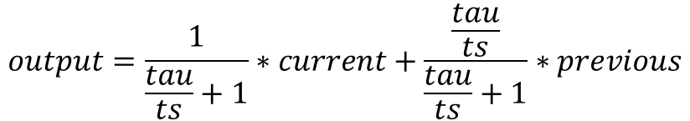
twist_controller: low_pass.py
Simple Low Pass Filter:
$$output=\frac{1}{\frac{tau}{ts}+1}∗current+\frac{\frac{tau}{ts}}{\frac{tau}{ts}+1}∗previous$$
tau =0, ts = 1 will shut off this filter

Slide 14
twist_controller: pid.py
INPUT
Error
Kp
1/Ts
Ki
prev
+
+
OUTPUT
Limit
1/Ts
Kd
-

